Slide 1
Real Time Analysis Of Bitcoin Network Congestion Using Spark Structured Streaming
Group 8
Tejaskumar Pareshbhai Patel - 885174433
Dhruv Ashokkumar Dhorajiya - 885177451
Project Link : https://github.com/tejs13/Spark-Streaming-BTC

Slide 2
Recap
Bitcoin un-confirmed transaction of which resides in mempool temporarily and added to ledger after confirmations.
Confirmation and addition of transaction to ledger takes different time, varying with transaction size, miner capability, transaction confirmation time and other factors.
Hence, transaction in Mempool, before being placed in ledger, shall rise the possibility of :
Flooding of Mempool
Due to large size transactions taking more time for confirmations, incoming transactions are more, leading to
Network Congestion - refers to the situation where the Bitcoin network is experiencing high transaction volume, resulting in longer confirmation times, higher transaction fees, and potential delays or failures in transaction processing

Slide 3
Tools and Tech Keywords
Python WebSocket
Apache Kafka
Zookeeper
Spark SQL
Spark Structured Streaming
Flask
ReactJS
Chart-js-2

Slide 4
Implementation Overview
The core of the application is Spark Structured Streaming with SparkSQL.
Deployed in :
Local Client mode
Following are the Breakouts:
Data Source
Capture Live Bitcoin Transactions
https://www.blockchain.com/explorer/api/api_websocket
Data Ingestion
Kafka Data Pipeline
Producer – consumer over topics

Slide 5
Cont..
Data Processing
Structuring raw data and logic implementation
Spark SQL
Data Streaming
Realtime Output sink to interfaces
Spark Structured Streaming
Output analysis
Live Chart, describing the current running transaction fees.
Python Flask, APIs developed for orchestration
Reactjs, Chart-js-2 : Dashboard screen development

Slide 6
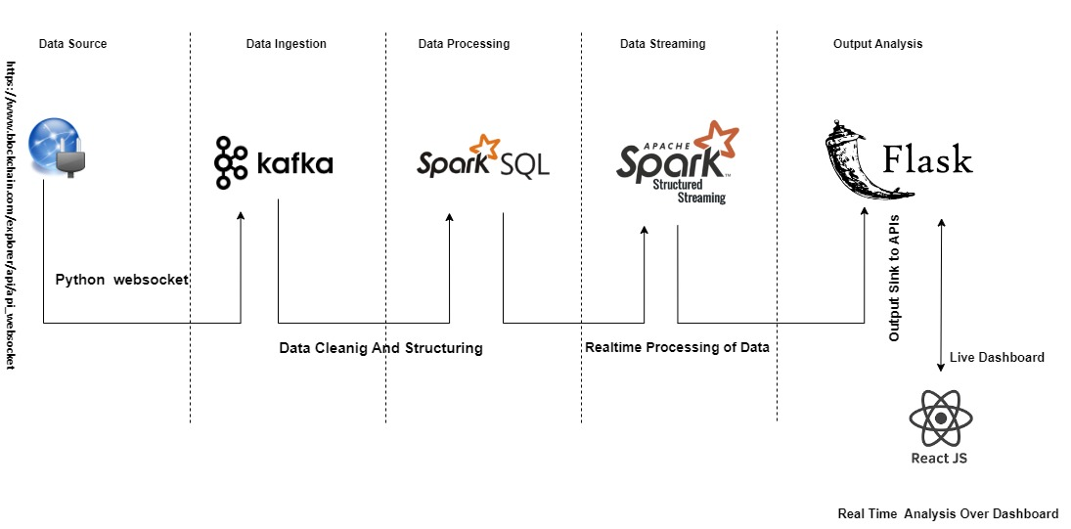
Execution Architecture

Slide 7
Data Source

Slide 8
Data Ingestion
while True: try: producer = KafkaProducer(bootstrap_servers='localhost:9092',api_version=(3, 2, 3)) print("Connected to Kafka!") break except kafka.errors.NoBrokersAvailable as e: print(e) time.sleep(3)
Get the Real Time bitcoin transactions, from endpoint :
wss://ws.blockchain.info/inv
Project File Name :
Web-socket.py
Tools and Tech :
Kafka
Python Web Socket
Usage of Python Websocket, to retrieve data from socket,
OnMessage, push raw data to Kafka Producer with new topic : “bitcoin-1”.
if __name__ == "__main__": websocket.enableTrace(True) ws = websocket.WebSocketApp("wss://ws.blockchain.info/inv", on_open=on_open, on_message=on_message, on_error=on_error, on_close=on_close) try: # Start the WebSocket connection ws.run_forever() finally: #Close the producer after use producer.flush(timeout=300) producer.close()
def on_message(ws, message): global cnt tx = json.loads(message) print("========================", cnt, type(message)) cnt += 1 # send BTC trnsaction to KAFKA, KAFKA active try: producer.send('bitcoin-1', str.encode(message)) except Exception as e: print(str(e), "PRODUCER EXCEPTION !!!!!!!!!!!!!!!!!!!!!!!!%%%%%%%%%%%%%%%%%%%%%%%%%") producer.flush() ws.close()

Slide 9
Data Processing
df = spark.readStream.format("kafka") \ .option("kafka.bootstrap.servers", KAFKA_BOOTSTRAP_SERVERS) \ .option("subscribe", KAFKA_TOPIC) \ .option("startingOffsets", "latest") \ .option("group_id", 'btc-group')\ .load() # .option("maxOffsetsPerTrigger", "100") \
Consume the Kafka Topic, named: “bitcoin-1”.
Project File Name :
Spark_stream_btc.py
Tools and Tech :
SparkSQL
Consumes raw bytes, convert to string , to JSON structured.
Structure the raw data to JSON, convert to dataframe, with the pre-defned schema.
Streaming applications needs to be windowed, to be run seamlessly and aggregation to be applied.
# Transformations and actions # all_cols_df = df.select("hash", "size", "vin_sz", "vout_sz", "in_addr", "in_value", "out_addr", "out_value") windowedCounts = df.groupBy(window(from_unixtime(df['time']), "2 second"), df['hash'], df['in_addr'], df["in_value"], df['out_addr'], df["out_value"], df["size"]).count() \ .withWatermark("window", "1 second") # windowedCounts = windowedCounts.agg(F.count(df['window']).alias("total_trans")) df = windowedCounts.select("window.start", "window.end", '*') # .drop('window')

Slide 10
Cont..
Logic Implementation :
Explode the Bitcoin transaction, separating out all inputs and outputs for a particular transaction hash.
Calculate the size of the transaction, in bytes
Aggregate the inputs and outputs for a hash transaction.
Calculate fees of a hash transaction by :
Aggregate Input – Aggregate Output / Size of the transaction

Slide 11
Data Streaming
df.writeStream \ .format("console") \ .outputMode("complete") \ .foreachBatch(process_each_batch)\ .start() \ .awaitTermination()
def process_each_batch(df, batch_id): global cnt ################### IN_VALUE AND OUT_VALUE GROUPBY #######################3 in_value_group = df.groupBy(df['hash'], df['in_addr'], df['in_value'], df["size"]).agg(F.first(df['hash'])) out_value_group = df.groupBy(df['hash'], df['out_addr'], df['out_value'], df["size"]).agg(F.first(df['hash'])) in_values = in_value_group.groupBy(col('hash'), col("size").alias("trans_size")).sum('in_value') out_values = out_value_group.groupBy(col('hash'), col("size")).sum('out_value') df = in_values.join(out_values, in_values['hash'] == out_values['hash']) df = df.withColumn("trans_fees", F.col("sum(in_value)") - F.col("sum(out_value)")) df = df.withColumn("trans_fees_2", df["trans_fees"] / df["trans_size"]) df = df.withColumn("trans_fees_2", F.bround("trans_fees_2", 2)) df = df.filter(F.col("trans_fees_2") >= 0) # taking out the average # df = df.select(F.avg("trans_fees_2")) # df = df.describe(["sum(in_value)", "sum(out_value)", "trans_fees_2"]) hash_cnt = df.count() df = df.agg({'trans_fees_2': 'avg', 'sum(out_value)': 'sum'}) df = df.toPandas() d = df.to_dict('records') d[0]["sum(sum(out_value))"] = d[0]["sum(sum(out_value))"] / 100000000 d[0]["total_hash"] = hash_cnt # send to flask send_data_to_flask(d) print(df, "Finally", "========================", cnt, type(df), hash_cnt) # print(df.show()) df.to_excel('BTC_Transaction_LIVE.xlsx', sheet_name='Sheet1', index=True) cnt += 1
Real Time Streaming of Transaction fees , with spark writestream.
Project File Name :
Spark_stream_btc.py
Tools and Tech :
Spark Streaming
Process data with streaming micro batch processing.
Outmode to be complete, which aggregates over all the incoming data, since the spark job submit.
i.e streaming query execution.
Finally, spark application will POST the processed data to flask, in real time via REST APIs.

Slide 12
Output sink
def send_data_to_flask(d): url = 'http://localhost:5001/updateData' t_d = {"vol": str(d[0]['sum(sum(out_value))']), "trans_fees": round(d[0]["avg(trans_fees_2)"], 4), "total_hash": d[0]["total_hash"]} try: response = requests.post(url, json=json.loads(json.dumps(t_d))) print(response.status_code, "Response Code") except Exception as e: pass
Spark streaming application sinks the processed data to Flask, via REST APIs.
Project File Name :
Spark_stream_btc.py
App.py
Tools and Tech :
Spark
Flask
Frontend, Reactjs Charts calls the API to refresh the dashboard screen, repeatedly.
@app.route('/updateData', methods=['POST']) def update_data(): global tags, dataValues, categoryValues, BTC_DATA data = ast.literal_eval(request.data.decode("utf-8")) BTC_DATA = data # print(f"labels received: {str(categoryValues)}") print(f"data received: {BTC_DATA} --- {type(BTC_DATA)}") return "success", 201 if __name__ == "__main__": app.run(host='localhost', port=5001, debug=True)

Slide 13
Data Analysis
dataRefresh = () => {
fetch('http://localhost:5001/refresh-data',
{
crossDomain:true,
method: "GET",
headers: { 'Content-Type': 'application/json' },
// body: JSON.stringify({
// username: user,
// password: pass,
// })
})
.then(response => response.json())
.then(data => this.setState({ BTCData: data.data }, () => { console.log(this.state.BTCData) }))
.catch((error) => { console.log(error) })
Frontend, calls the REST APIs of Flask, to update the chart, repeatedly, to get the new processed micro batch data output.
Project File Name :
Src/BigData/Screens/BTCBarChart.jsx
Tools and Tech :
ReactJS
Chart-js-2
Processed data is loaded to chart, to render/re-render new metrics i.e real time streaming.

Slide 14
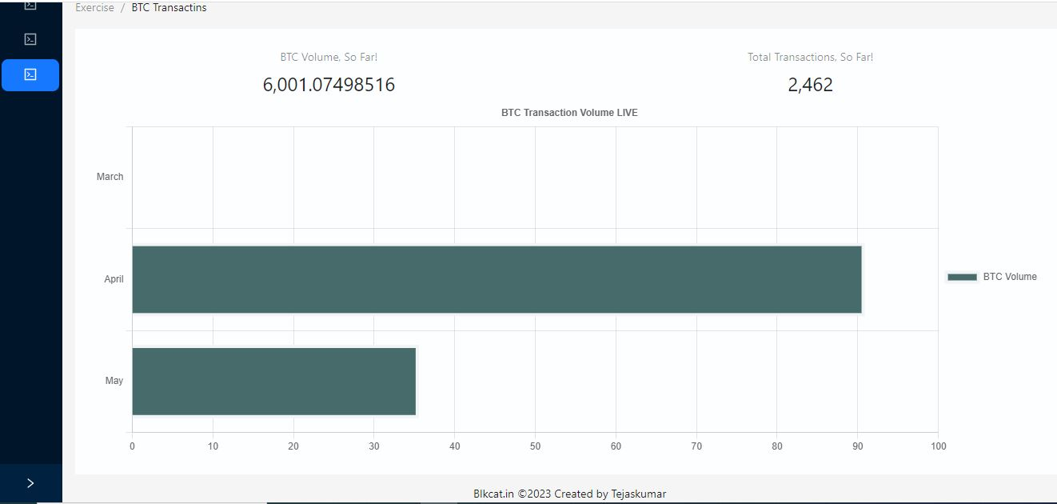
Cont..
Real time Dashboard, showcase the running cumulative average transaction fees, over Bitcoin Transaction.
For the current month, may, the real time metrics :
total transactions
total Bitcoin Volume transacted since the spark job submit.

Slide 15
Congestion Analysis
When there are a large number of transactions waiting to be added to the blockchain, miners prioritize transactions based on the transaction fees that users are willing to pay.
During times of network congestion, transaction fees tend to increase as users compete to have their transactions processed quickly.
By analyzing the trends in transaction fees, we can gain insights into the level of network congestion.
In sum, Higher fees == Network Congestion state

Slide 16
Cont ..
For April:
60 sat /bytes - Low Transaction - Base Normal Health
Source :
https://www.blockchain.com/explorer/charts/fees-usd-per-transaction
https://bitcoiner.live/
For May, estimate, i.e. Realtime Streaming :
98 sat /bytes - High Transaction - Reference to April, Congestion Health

Slide 17
Causes
This can happen when,
There is a sudden increase in the number of users,
A surge in demand for Bitcoin transactions,
Or a limitation in the network's capacity to process transactions

Slide 18
Fees Prediction – Attempt
Linear Regression, a statistical technique used to model the relationship between a dependent variable (also known as the outcome or response variable) and one or more independent variables (also known as predictors or explanatory variables).
Project File :
Features : size
Label : trans_fees_2

Slide 19
Limitations
Network Congestion is dependent upon various other factors, apart from transaction size.
Transaction Volume
Network Latency
Transaction Confirmation Time
Source: https://wirexapp.com/help/article/my-blockchain-fee-is-too-high-why-what-should-i-do-0079
https://fortris.com/blog/bitcoin-transaction-time
Hence, the linear relationship doesn’t exists, to apply for Linear Regression Model.

Slide 20
DataProc Cluster - Attempt
GCP Dataproc (Google Cloud Platform Dataproc) is a managed big data processing service offered by Google Cloud Platform (GCP).
Fully managed service that allows users to process large amounts of data using popular open-source big data technologies such as Apache Hadoop, Apache Spark, Apache Hive, Apache Pig, and Apache Flink.
Flexible cluster sizing and autoscaling based on demand.

Slide 21
Cont ..

Slide 22
Limitations and Issues
No support of Kafka, in GCP, instead to use pub/sub.
Recent support for spark structured streaming,
Source : https://cloud.google.com/blog/products/data-analytics/pubsub-lites-apache-spark-structured-streaming-connector-is-now-generally-available
Stream Processing have lots of jar version dependencies, hence the orchestration between different components of the application is difficult.

Slide 23
Use Cases
Real-time analytics:
With Spark Structured Streaming, you can analyze Bitcoin transaction data in real-time as it is being processed on the network. This can be useful for monitoring network congestion and identifying trends in transaction fees over time.
Optimization of transaction fees:
Identify optimal transaction fees for different types of transactions based on factors such as transaction size and network congestion.
Research and analysis :
Can be used to perform research and analysis on the Bitcoin network, such as identifying trends in transaction fees over time and comparing transaction fees across different cryptocurrencies.

Slide 24
Project File Structure
Spark Streaming
spark-stream-btc.py
Kafka Producer
Web-socket-kafka
Flask APIs:
App.py
Live Dashboard Screen :
Src/BigData/Screens/BTCBarChart.jsx

Slide 25
Conclusion
Spark Structured Streaming applications can be a powerful tool for analyzing Bitcoin transaction data and calculating average transaction fees in real-time.
By analyzing patterns and trends in transaction fees, Spark Structured Streaming can help identify optimal transaction fees, monitor network congestion, and improve resource allocation for Bitcoin mining operations.
However, it is important to approach Spark Structured Streaming with careful planning and consideration of the technical and resource requirements involved.

Slide 26
References
https://spark.apache.org/docs/latest/streaming-programming-guide.html#overview
https://medium.com/expedia-group-tech/apache-spark-structured-streaming-output-sinks-3-of-6-ed3247545fbc
https://cloud.google.com/blog/products/data-analytics/pubsub-lites-apache-spark-structured-streaming-connector-is-now-generally-available
https://wanwenli.com/blockchain/2018/06/28/Bitcoin-lightning-network.html

Slide 27
Thank you
Questions ?

